Slide 1

IBM PBEL 2.0
Internship
Topic- Hotel Booking Chains
COLLEGE:- VIVEKANANDA GLOBAL UNIVERSITY JAIPUR
Submitted to:-
Priyanshu Sir
Submitted By:- Vinay Kumar (24TEC2AIDS079) Erp-34796(Btech)

Slide 2

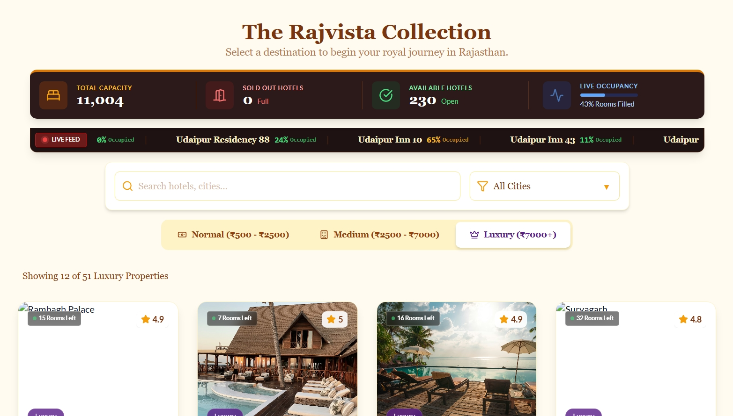
Introduction
A hotel booking chain refers to a group or network of hotels that operate under the same brand name, management system, and standards. These hotels may be located in different cities or countries but provide similar services, facilities, and quality to customers

Slide 3
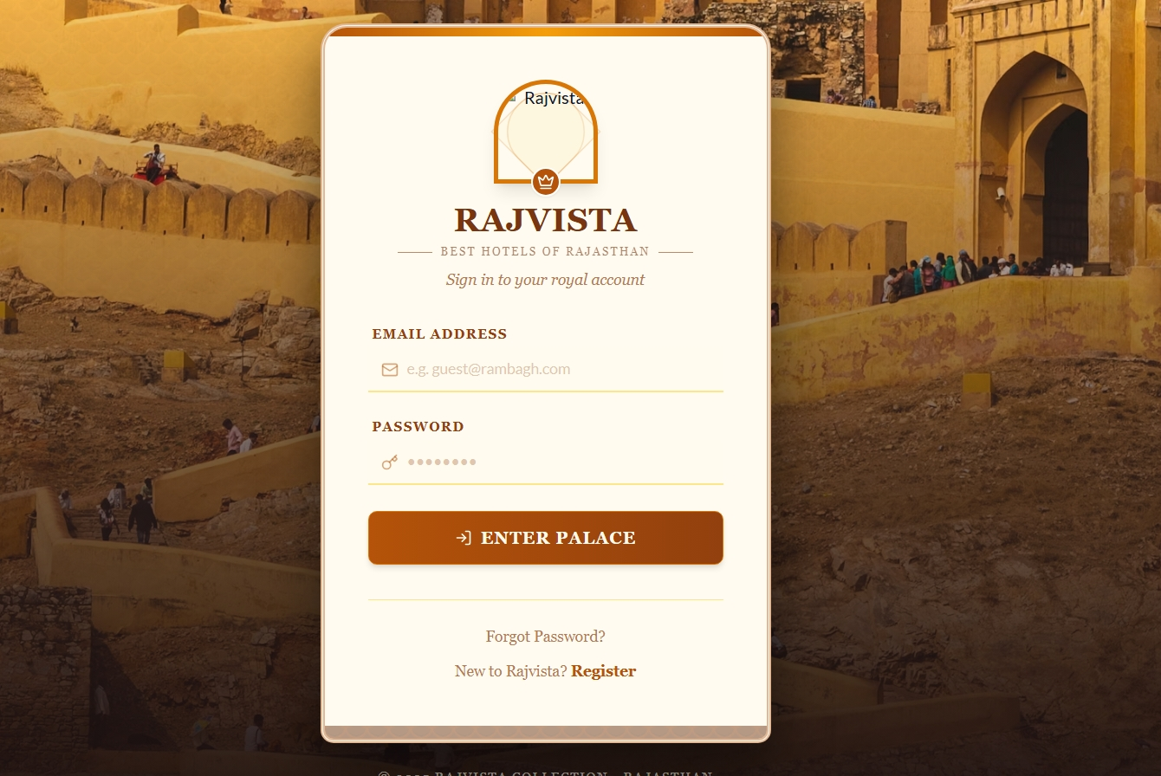
Login page
A login page allows users to securely access a website or application. The user enters their registered email and password to verify their identity. In addition, face authentication uses the device camera to scan and match the user’s face with stored data. This system provides extra security and protects the account from unauthorized access.

Slide 4
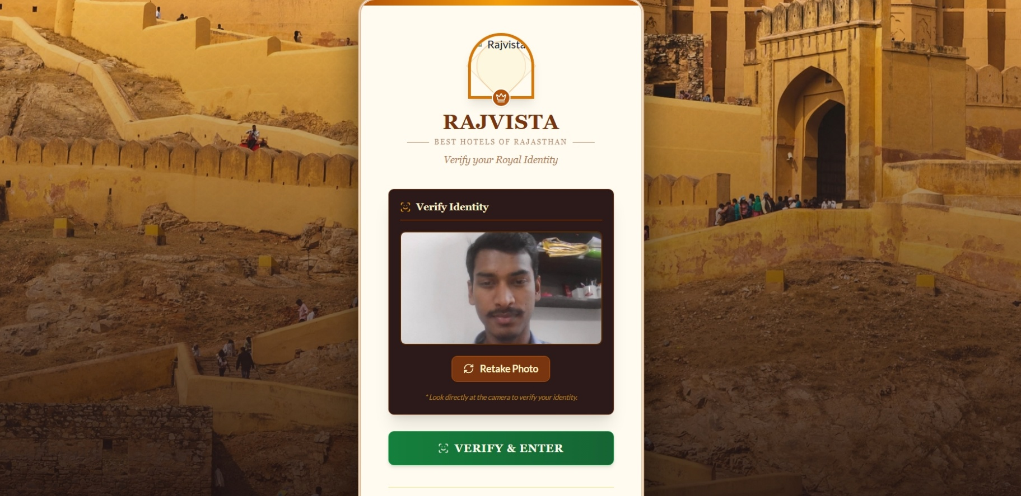
FACE AUTHENTICATION
Face authentication is used for secure login. The user must capture their face using the camera. If the face is not detected or does not match, the system asks the user to capture the face again.

Slide 5
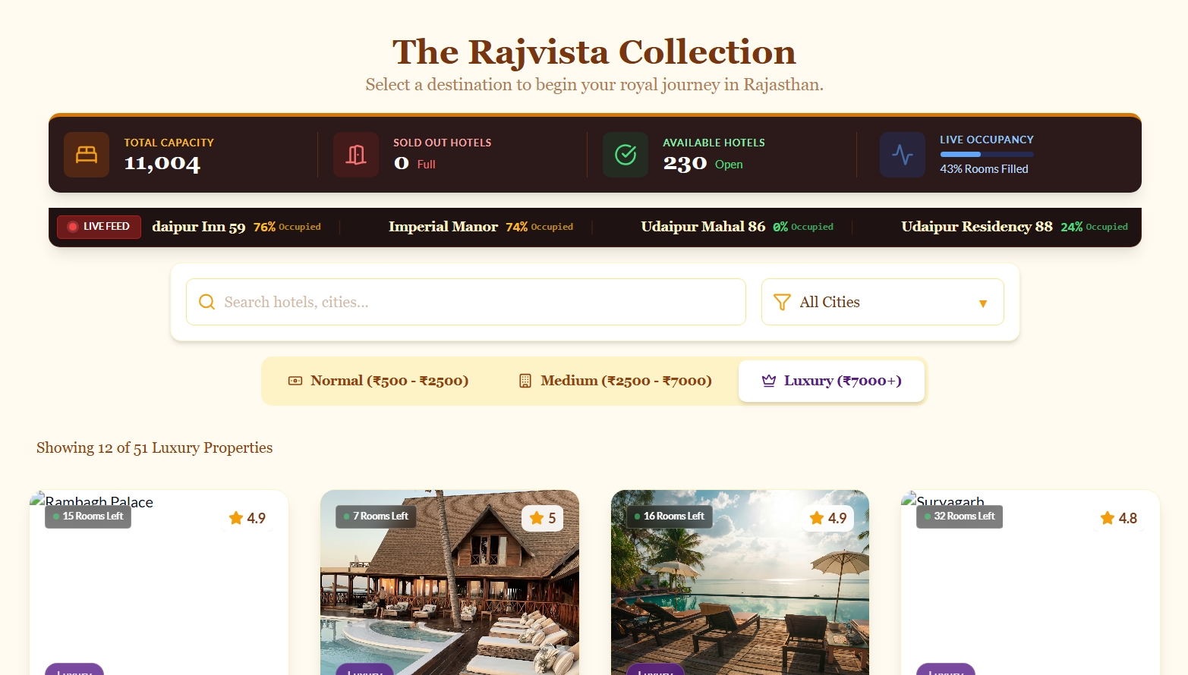
HOME PAGE
Total capacity
Current time capacity
Facilities
available percentage
Live occupancy
Rating
Filter out city

Slide 6

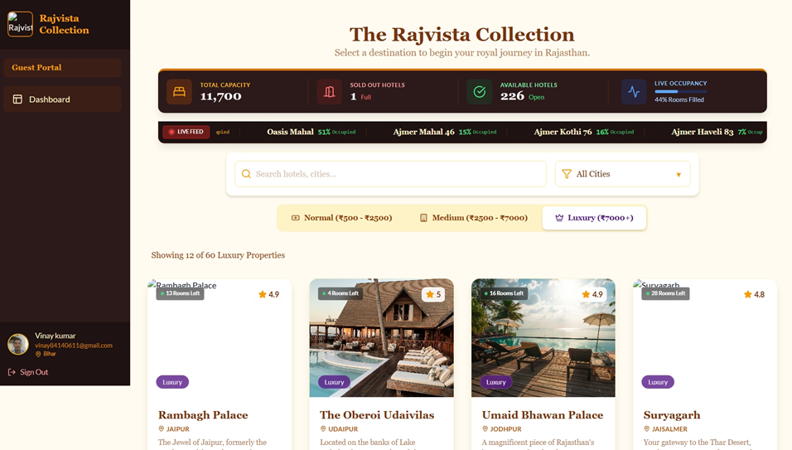
Dashboard
The dashboard shows an overview of the hotel booking system, including total capacity, available hotels, sold-out hotels, and live room occupancy. It also allows users to search and filter hotels by city and price category.

Slide 7

HOTEL BOOKING
The hotel booking process allows users to search for hotels, select a room, and enter their details. Users can also apply available offers or discounts before confirming the booking. The reservation is then completed through online payment or confirmation.

Slide 8
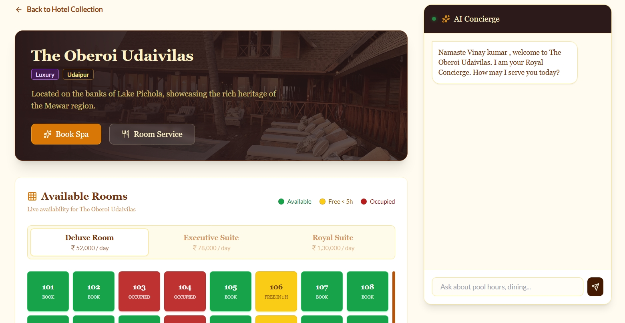
COST EFICIENCNCY
There arer three type of room provide by the our website
Normal
Medium
Higher
The cost is according to your facilities .We are providing the real time occupied space.

Slide 9
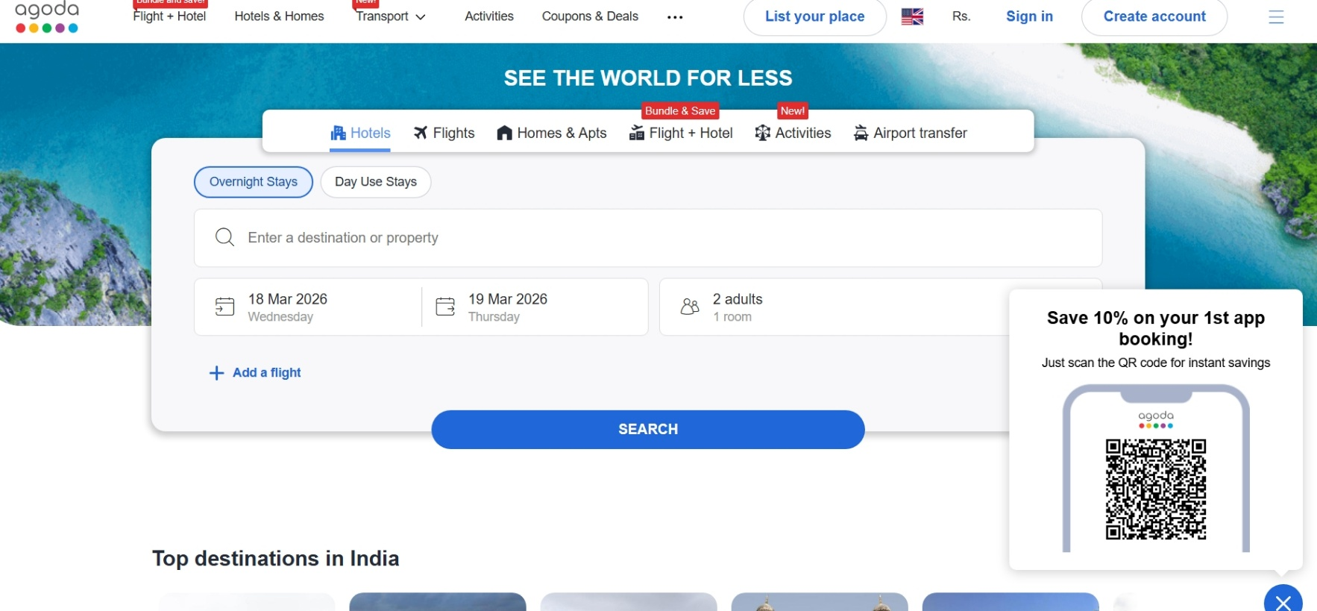
Conclusion
Finally we are provide the vacant room and you click the room go to there won website and book now.

Slide 10
Thankyou

